Slide 1

Academic Session 2025-26
ODD Semester Jul-Dec 2025
UNIVERSITY INSTITUTE OF ENGINEERING
COMPUTER SCIENCE ENGINEERING
Bachelor of Engineering
Semester: 6th
Design and Analysis of Algorithms
(23CSH-301/ITH-301)
Unit No. 1 Chapter No. 1 Lecture No.1
Topic : Introduction to Algorithm
Richa Dhiman E11307 Assistant Professor

Slide 2
1
Learning Objectives & Outcomes
Objective:
To understand meaning and characteristics of algorithms
Outcome:
Student will understand the meaning of algorithm and its characteristics.

Slide 3
2
Design and Analysis of Algorithm
Design and Analysis of Algorithm is very important for designing algorithm to solve different types of problems in the branch of computer science and information technology.

Slide 4
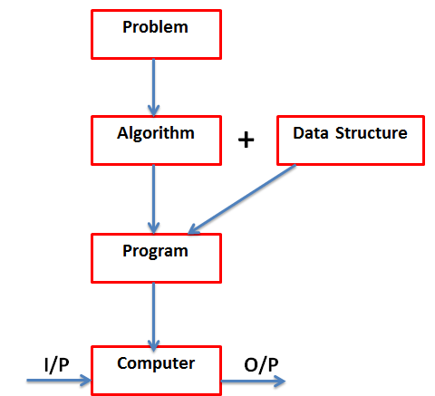
3
Basic Concept

Slide 5
4
What is Algorithm?
A finite set of instruction that specifies a sequence of operation is to be carried out in order to solve a specific problem or class of problems is called an Algorithm.
Set of rules to obtain the expected output from the given input
Input
Output

Slide 6
5
Characteristics of an Algorithm
Input − An algorithm should have 0 or more well-defined inputs.
Output − An algorithm should have 1 or more well-defined outputs, and should match the desired output.
Unambiguous/ Definiteness − Algorithm should be clear and unambiguous.
Finiteness − Algorithms must terminate after a finite number of steps.
Feasibility − Should be feasible with the available resources.
Independent − An algorithm should have step-by-step directions, which should be independent of any programming code.

Slide 7
6
Common terms used in Algorithm
Variable: specific location in computer memory used to store one and only one value.
Datatypes: the type of data a variable can hold
Statement : line of code

Slide 8
Applications
7
Search Engines: PageRank algorithm, crawling, indexing (e.g., Google Search)
Route Optimization: Dijkstra’s algorithm, A*, Bellman-Ford in Google Maps, logistics
Scheduling: Job-shop scheduling in manufacturing, CPU scheduling in OS.
Sorting Algorithms: Quick Sort, Merge Sort, Heap Sort in database operations
String Matching: KMP, Rabin-Karp in plagiarism detection, bioinformatics (DNA sequence analysis)
Pattern Recognition: Used in OCR (Optical Character Recognition), handwriting analysis

Slide 9
8
Algorithm Specification
Algorithm can be described in three ways:
1) Natural language like English
2) Graphic representation called flowchart
3) Pseudo-code Method

Slide 10
9
Algorithm of linear search :
Start from the leftmost element of arr[] and one by one compare x with each element of arr[].
If x matches with an element, return the index.
If x doesn’t match with any of elements, return -1.

Slide 11
10
Pseudocode for Linear Search :
FUNCTION linearSearch(list, searchTerm):
FOR index FROM 0 -> length(list):
IF list[index] == searchTerm
THEN RETURN index
ENDIF
ENDLOOP
RETURN -1
END FUNCTION

Slide 12
Program for Linear Search :
11
int search(int arr[], int n, int x)
{
int i;
for (i = 0; i < n; i++)
if (arr[i] == x)
return i;
return -1;
}

Slide 13
Need of Algorithm
12
1. To understand the basic idea of the problem.
2. To find an approach to solve the problem.
3. To improve the efficiency of existing techniques.
4. To understand the basic principles of designing the algorithms.
5. To compare the performance of the algorithm with respect to other techniques.
6. It is the best method of description without describing the implementation detail.
7. The Algorithm gives a clear description of requirements and goal of the problem to the designer.

Slide 14
Need of Algorithm (CONTD…)
13
8. A good design can produce a good solution.
9. To understand the flow of the problem.
10. To measure the behavior (or performance) of the methods in all cases (best cases, worst cases, average cases)
11. With the help of an algorithm, we can also identify the resources (memory, input-output) cycles required by the algorithm.
12. With the help of algorithm, we convert art into a science.
13. To understand the principle of designing.
14. We can measure and analyze the complexity (time and space) of the problems concerning input size without implementing and running it; it will reduce the cost of design.

Slide 15
Algorithm vs Program
14
A finite set of instructions that specifies a sequence of operations to be carried out to solve a specific problem of a class of problem is called an algorithm.
Program doesn't have to satisfy the finiteness condition. For example, we can think of an operating system that continues in a "wait" loop until more jobs are entered. Such a program doesn't terminate unless the system crashes.

Slide 16
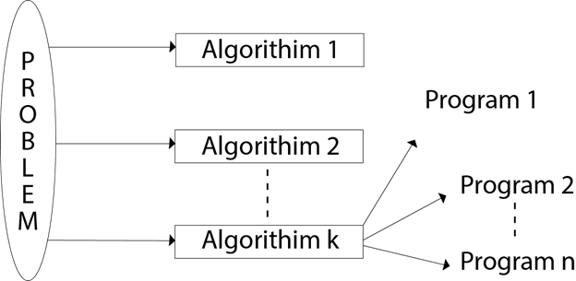
15

Slide 17
Issues or study of Algorithm
16
How to device or design an algorithm --> creating and algorithm.
How to express an algorithm --> definiteness.
How to analysis an algorithm --> time and space complexity.
How to validate an algorithm --> fitness.
Testing the algorithm --> checking for error.

Slide 18
Summary
17
Introduction to Algorithm
Characteristic of algorithm
Needs and specification of algorithm

Slide 19
18
Next Lecture
Time and Space complexity
Average and worst-case Analysis
Asymptotic notations

Slide 20
19
Quiz
1. Which of the following best defines an algorithm?
A. computer programming language B. A step-by-step procedure to solve a problem C. A type of computer D. A software application
2. Every algorithm must have a definite starting and ending point?

Slide 21
20
References/ Articles/ Videos
Text books:
Cormen, Leiserson, Rivest, Stein, “Introduction to Algorithms”, Prentice Hall of India, 3rd edition 2012. problem, Graph coloring.
Horowitz, Sahni and Rajasekaran, “Fundamentals of ComputerAlgorithms”, University Press (India), 2nd edition
Websites:
https://www.geeksforgeeks.org/introduction-to-algorithms/
https://www.tutorialspoint.com/design_and_analysis_of_algorithms/index.htm

Slide 22
21
Faculty-curated videos, NPTEL, Coursera, LinkedIn, or other relevant learning resources
https://onlinecourses.nptel.ac.in/noc23_cs96/preview
https://nptel.ac.in/courses/106106131
https://nptel.ac.in/courses/106106208
https://www.linkedin.com/learning/learning-algorithms

Slide 23
23
Class-Wise Feedback

Slide 24
24
Thank You
For queries
Email: richa.e11307@cumail.in

